Slide 1
Introduction to the Roman Empire
Understanding the History and Legacy of Ancient Rome

Slide 2
Founding of Rome
The Roman Empire originated from the city of Rome, which was founded in 753 BC by Romulus and Remus.
According to Roman mythology, Romulus and Remus were twin brothers who were raised by a she-wolf and later went on to establish the city of Rome.
The exact historical details of Rome's founding are still debated by historians.

Slide 3
Expansion and Conquest
The Roman Empire gradually expanded its territory through military conquests and diplomacy.
Under the leadership of various emperors, Rome conquered and assimilated numerous civilizations, including the Greeks, Egyptians, and Gauls.
The vast Roman Empire stretched from Britain in the north to Egypt in the south, and from Spain in the west to Persia in the east.

Slide 4
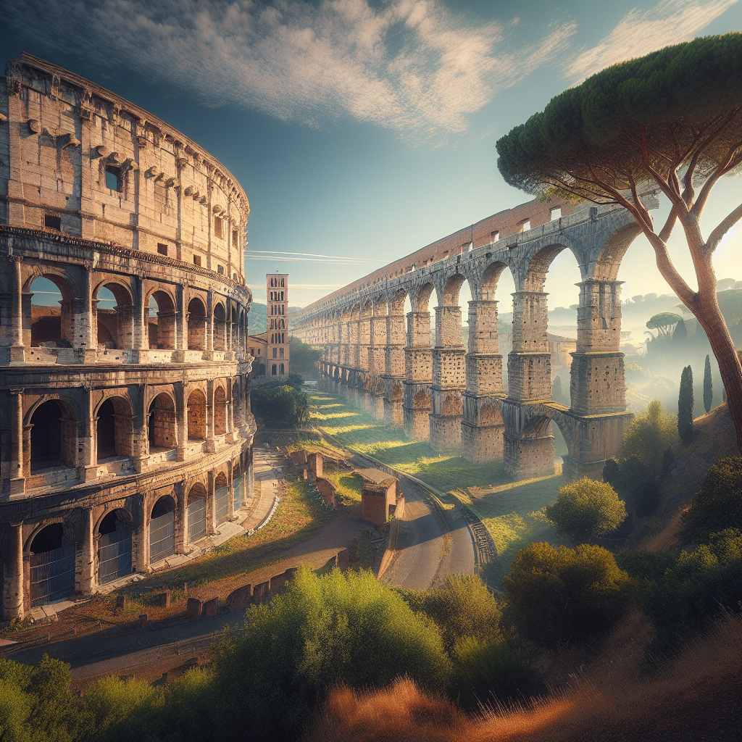
Roman Architecture and Engineering
The Romans were known for their impressive architectural and engineering feats.
Examples of Roman architecture include the Colosseum, which was a massive amphitheater used for gladiatorial contests and public spectacles.
The Romans also constructed aqueducts to supply water to their cities, showcasing their advanced engineering skills.
Colosseum

Slide 5
Roman Culture and Society
Roman culture was heavily influenced by Greek culture, and the Romans adopted many aspects of Greek art, philosophy, and literature.
The Roman society was hierarchical, with the emperor at the top followed by nobles, merchants, and slaves.
The Romans also enjoyed various forms of entertainment, such as gladiator fights and chariot races.

Slide 6
Roman Law and Governance
The Romans established a sophisticated legal system that influenced the development of Western legal systems.
Roman law emphasized principles such as equality before the law and the right to a fair trial.
The Roman Empire was governed by an emperor who held absolute power, although the empire did have a Senate that played a role in decision-making.

Slide 7
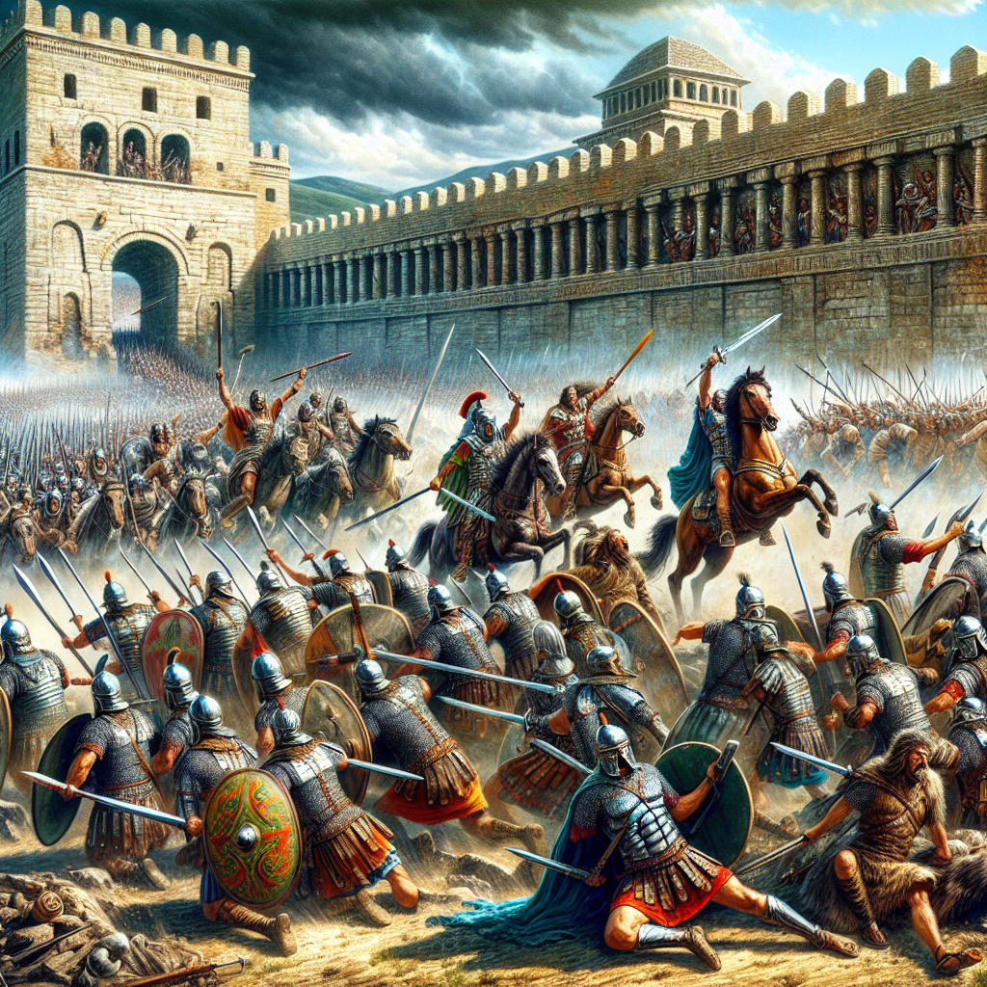
Decline and Fall of the Roman Empire
The Roman Empire started to decline in the 3rd century AD due to internal conflicts, economic instability, and barbarian invasions.
The empire eventually split into two parts, the Western Roman Empire and the Eastern Roman Empire (Byzantine Empire).
In 476 AD, the Western Roman Empire fell to barbarian invasions, marking the end of ancient Rome.
Barbarian Invasions

Slide 8
Legacy of Ancient Rome
The Roman Empire left a lasting impact on Western civilization.
Roman law and governance influenced modern legal systems and forms of government.
Roman architecture and engineering techniques continue to inspire and awe people to this day.

Slide 9
References
1. Beard, M. (2015). SPQR: A History of Ancient Rome. W. W. Norton & Company.
2. Grant, M. (1978). The History of Rome. Weidenfeld & Nicolson.
3. Goldsworthy, A. (2007). Caesar: Life of a Colossus. Yale University Press.

Slide 10
Thank You
Thank you for your attention!
Any questions?

